Slide 1
Chapter Five
Free Radical Reactions
Free Radicals
Chain Free Radical Reactions
Nonchain Free Radical Reactions
Miscellaneous Free Radical Reactions

Slide 2
Free Radicals
Discovery of free radicals
Prof. Gomberg was the first to characterize a free radical in 1900.
Properties of free radicals
1. One or more unpaired electrons.
2. Electron-deficient species.
3. Uncharged molecules.
Shape of free radicals

Slide 3
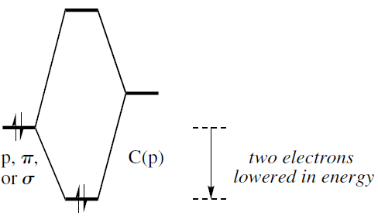
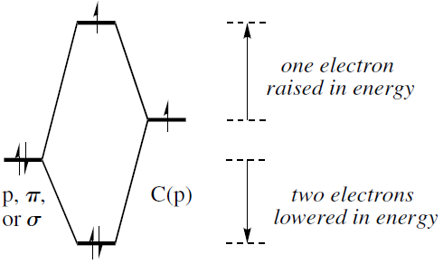
Free Radicals
Stability of free radicals
Both alkyl radicals and carbocations are electron-deficient species, and the structural features that stabilize carbocations also stabilize radicals. Alkyl radicals are stabilized by adjacent lone-pair-bearing heteroatoms and π bonds, just as carbocations are, and the order of stability of alkyl radicals is 3° > 2° > 1°(Hyperconjugation).
Differences between free radicals and carbocations
1. The very unstable aryl and 1° alkyl carbocations are almost never seen, whereas aryl and
1° alkyl radicals are reasonably common.
2. The amount of extra stabilization that adjacent lone pairs, bonds, and bonds provide to
radicals is not as great as that which they provide to carbocations.
carbocation
Free radical

Slide 4
Free Radicals
3. Captodative effect: Free radicals are stabilized both by electron-rich bonds, like C––C
bonds, and by electron-poor bonds, like C––O bonds. However, an electronrich bond is
more stabilizing than one that is electron-poor. When a radical is substituted by both an
electron-donating and an electron-withdrawing group, the total stabilization is greater
than the sum of the parts in a phenomenon called the captodative effect..
Stability of free radical on heteroatoms.
Neutral free radicals are electron-deficient, so radicals centered on less electronegative elements are lower in energy than radicals centered on more electronegative elements. As a result, the order of stability for first-row radicals is alkyl (·CR3) > aminyl (·NR2) > alkoxyl (RO·), and for halogens it is I· > Br· > Cl· > F·.
Steric shielding of the radical centers.

Slide 5
Free Radicals
Generation of free radicals
1. Sigma-bond homolysis
stable benzylic radical
diradical: triplet carbene
nitrene: N analogs of carbenes

Slide 6
Free Radicals
Generation of free radicals
2. double-bond homolysis: The weaker the π bond, the easier it is to photoexcite.
cis
trans
3. The cycloaromatization of certain highly unsaturated organic compounds can give
diradicals.
Bergman cyclization of a enediyne
Cyclization of allenylenynes.(1,2,4-trien-6-ynes)

Slide 7
Free Radicals
4. A compound with an electron in a high-energy orbital may transfer the electron to a
compound that has a lower energy orbital.
(a) After electron is accepted, the product is called a radical anions.
ortho- or para-
Ex: Explain why we use benzophenone as indicator in drying solvents(THF and ether) system(water and oxygen free).
deep blue or purple
(b) One-electron oxidation of organic substrates gives radical cations.
One-electron oxidizing agents
Ex:

Slide 8
Free Radicals: Typical Reactions
1. Addition to a π bond: similar to the addition of π bods to carbocations.
2. Fragmentation: similar to the fragmentation of a carbocation.

Slide 9
Free Radicals: Typical Reactions
3. Atom abstraction reaction:
Y= H or halogen
Bu₃Sn• can itself be generated by H abstraction from Bu₃SnH. Bu₃Sn• is often used to abstract halogen atoms X(Br or I) from C–X bonds.
AIBN
4. Radical-radical combination: Most free radicals are very unstable because they undergo
very rapid radical-radical combination.

Slide 10
Free Radicals: Typical Reactions
5. Disproportionation: two radicals with the same formula become two products with
different formulas.
6. One-electron transfer: in the presence of an oxidizing or reducing agent to give an
even-electron species.
One-electron reduction
One-electron oxidadation

Slide 11
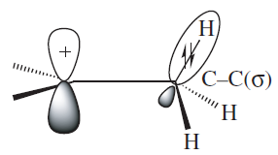
Free Radicals: Typical Reactions
6. Rearrangement:
Carbocations can undergo 1,2-hydride or alkyl shift.
1,2-hydride
shift
HOMO
The concerted 1,2-shift doesn’t occur in free radicals.
LUMO
However, unsaturated groups can shift by addition-fragmentation mechanism.
Ex: Please draw the mechanism of following reaction.

Slide 12
Chapter Five
Free Radical Reactions
Free Radicals
Chain Free Radical Reactions
Nonchain Free Radical Reactions
Miscellaneous Free Radical Reactions

Slide 13
Chain Free Radical Reactions: Substitution Reaction
1. Halogenation of alkanes
Initiation: Sigma-bond homolysis
Propagation: atom abstraction reaction
Termination: radical-radical combination and disproportionation
Ex: Draw the mechanism for the reaction.

Slide 14
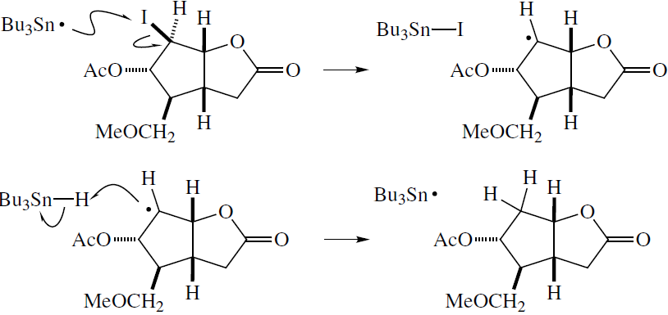
Chain Free Radical Reactions: Substitution Reaction
2. Dehalogenation
Initiation:
Propagation:

Slide 15
Chain Free Radical Reactions: Substitution Reaction
3. Carton-McCombie reaction: Alcohol is converted into a alkane.
Addition to a π bond
Fragmentation
Atom abstraction reaction
4. Autoxidation: Key step in the industrial synthesis of phenol and acetone.
Ex: Draw the mechanism for all three steps of the phenol synthesis.

Slide 16
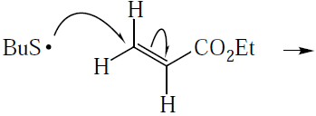
Chain Free Radical Reactions: Addition and Fragmentation Reaction
1. Carbon-Heteroatom Bond-Forming Reactions
a. C-X bond
Markovnikov addition of HBr to alkene
anti-Markovnikov addition of HBr to alkene
Ex: Please draw the mechanism of above reactions.
b. C-S bond
Initiation:
Propagation:

Slide 17
Chain Free Radical Reactions: Addition and Fragmentation Reaction
2. Carbon-Carbon Bond-Forming Reactions
a. Polymerization of ethylene to give polyethylene
Initiation:
Propagation:
Side chain branching:
Ex: Please draw the mechanism of above reactions.

Slide 18
Chain Free Radical Reactions: Addition and Fragmentation Reaction
b. Cyclization: five-member ring is better than six-member ring.
Initiation:
Propagation:

Slide 19
Chain Free Radical Reactions: Addition and Fragmentation Reaction
c. Other cases
Initiation:
Propagation:

Slide 20
Chain Free Radical Reactions: Addition and Fragmentation Reaction
Please draw the mechanism of above reactions.
(a)
(e)
(b)
(c)
(d)

Slide 21
Chapter Five
Free Radical Reactions
Free Radicals
Chain Free Radical Reactions
Nonchain Free Radical Reactions
Miscellaneous Free Radical Reactions

Slide 22
Nonchain Free Radical Reactions: Photochemical Reactions
The photoexcitation of a carbonyl compound to give a 1,2-diradical is often followed by a fragmentation reaction.
Norrish type one:
Norrish type two:
1,4-diradical

Slide 23
Nonchain Free Radical Reactions: Photochemical Reactions
b. Pinacol coupling
c. Barton reaction: an alkyl nitrite is converted into an alcohol-oxime.
nitrite
oxime
alcohol

Slide 24
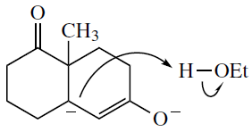
Nonchain Free Radical Reactions: Reductions with Metals
a. Addition of H₂ across π Bonds
1. An electron is transferred from the metal to the substrate to give a radical anion.
2. A second electron transfer to the radical anion occurs to give a closed-shell dianion.
3. The dianion is protonated to give a closed-shell anion.
Ex:
Mechanism:
Please draw the mechanism

Slide 25
Nonchain Free Radical Reactions: Reductions with Metals
b. Birch reaction: regioselectivity
ED: electron-donating group
EW: electron-withdrawing group
ortho-, meta-
ipso-, para-

Slide 26
Nonchain Free Radical Reactions: Reductions with Metals
Birch reaction: regioselectivity
Please draw the mechanism

Slide 27
Nonchain Free Radical Reactions: Reductions with Metals
c. Reductive coupling: Pinacol coupling
Please draw the mechanism

Slide 28
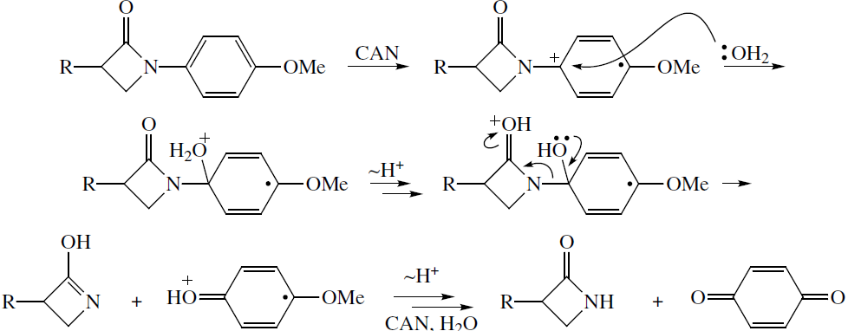
Nonchain Free Radical Reactions: One-Electron Oxidation
One-electron oxidizing agents
Ex:
Mechanism:

Slide 29
Nonchain Free Radical Reactions: Cycloaromatization
Bergman cyclization of a enediyne
Cyclization of allenylenynes.(1,2,4-trien-6-ynes)
Ex:
Mechanism:

Slide 30
Chapter Five
Free Radical Reactions
Free Radicals
Chain Free Radical Reactions
Nonchain Free Radical Reactions
Miscellaneous Free Radical Reactions

Slide 31
Miscellaneous Free Radical Reactions
a. 1,2-Anionic Rearrangements
Stevens rearrangement
Wittig rearrangement
Please draw the mechanism
(a)
(b)

Slide 32
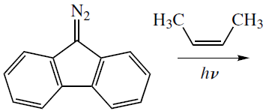
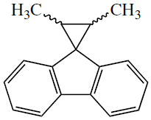
Miscellaneous Free Radical Reactions
b. Reactions of triplet carbenes and nitrenes
diradical: triplet carbene
nitrene: N analogs of carbenes
Ex:
Mechanism:
Ex:
Mechanism:

